Slide 1
Vaporisation
Year 7 Science

Slide 2
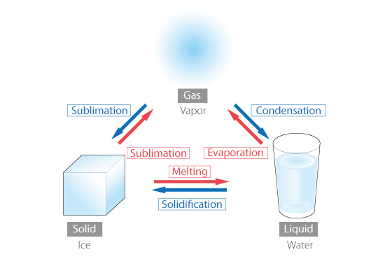
Review
Arrange the labels and arrows to show phase changes.

Slide 3
Learning Intentions
Mixtures, including solutions, contain a combination of pure substances that can be separated using a range of techniques.

Slide 4
Success criteria
Distinguish between vaporisation, boiling and evaporation.
Explain what happens to particles during vaporisation.

Slide 5


Vaporisation
Vaporisation is the phase change from liquid to gas.
At temperatures below boiling point, vaporisation is called evaporation and the gas will leave from the top of the liquid.
At temperatures above boiling point, vaporisation is called boiling and the gas will form bubbles within the liquid.

Slide 6
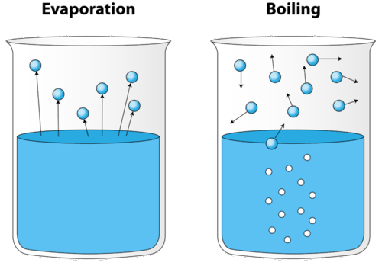
Vaporisation

Slide 7
Experiment: Rates of evaporation

Slide 8
Success criteria
Distinguish between vaporisation, boiling and evaporation.
Explain what happens to particles during vaporisation.

